Slide 1

Statically Made RNN - Packing Outputs

Slide 2
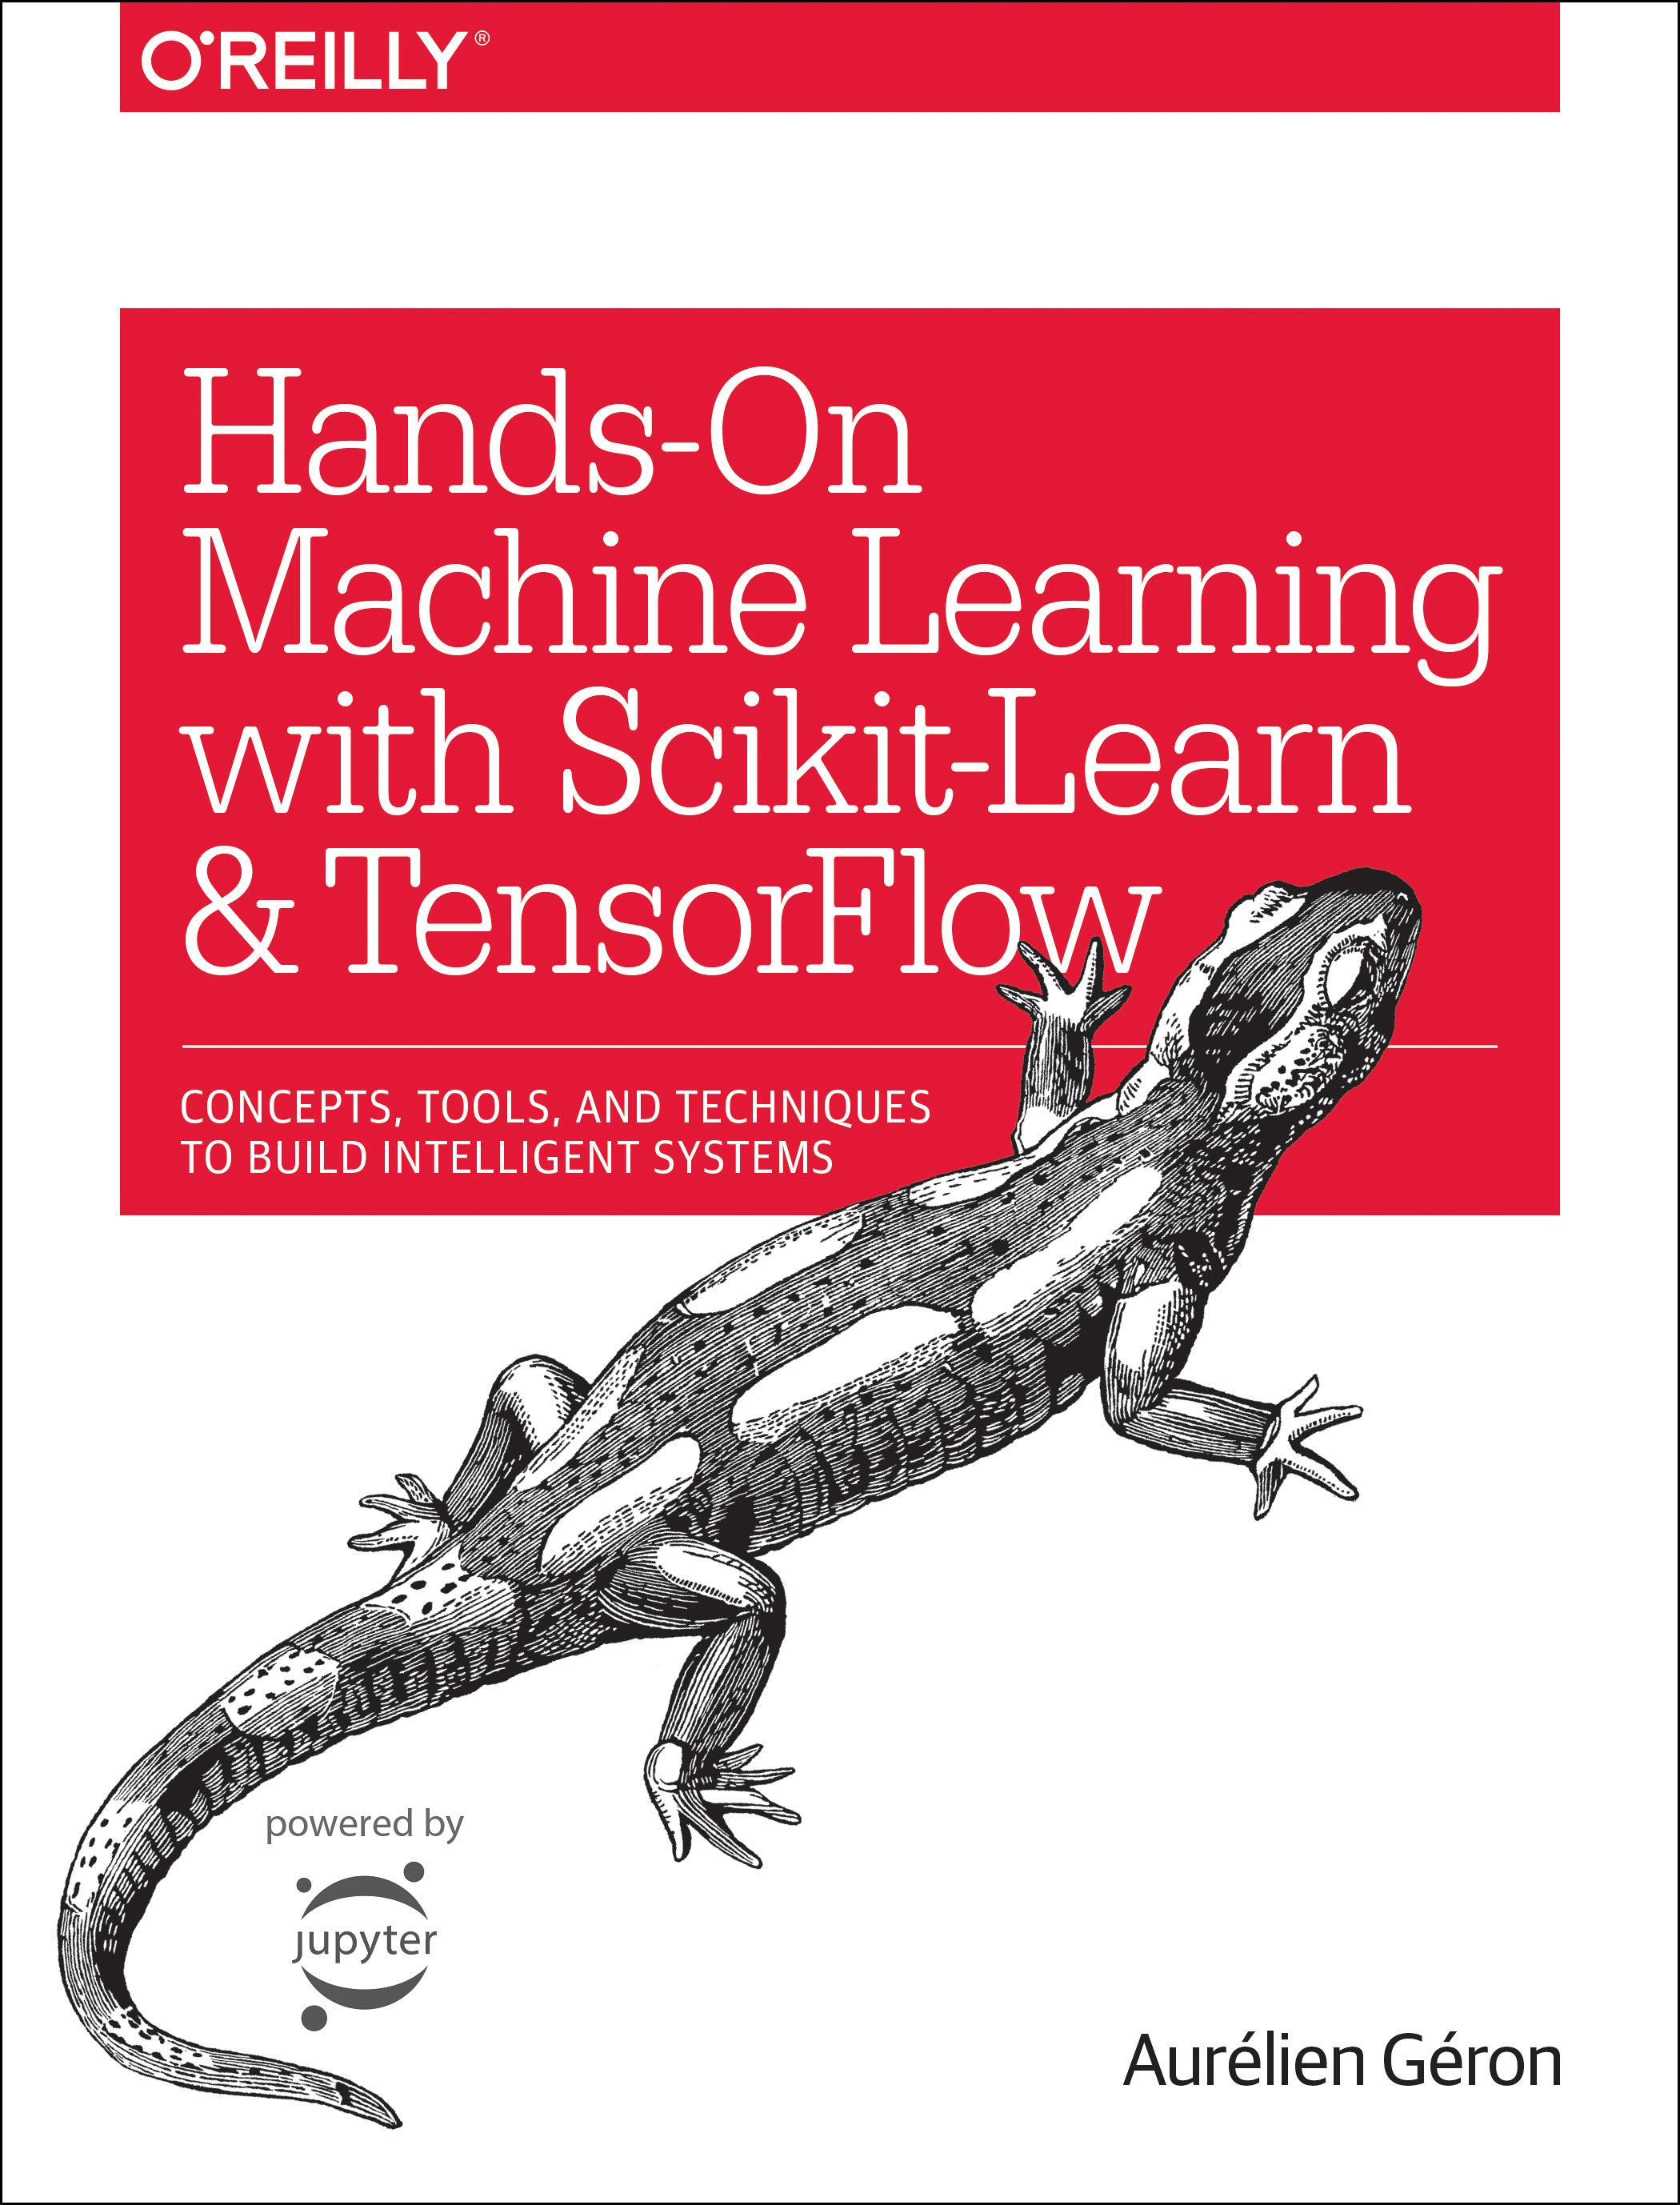
Reference
Chapter 14 (O'Reilly) of Hands-On ML
Youtube
Code

Slide 3
Data

Slide 4
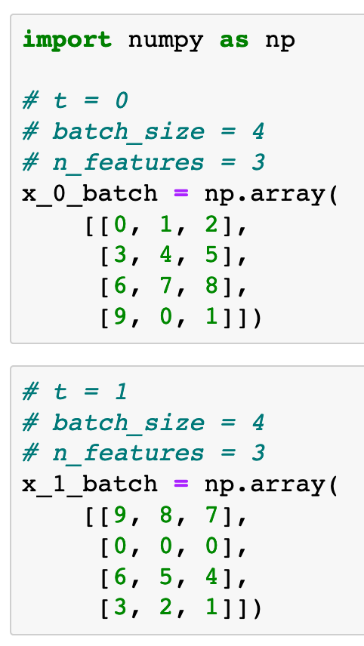
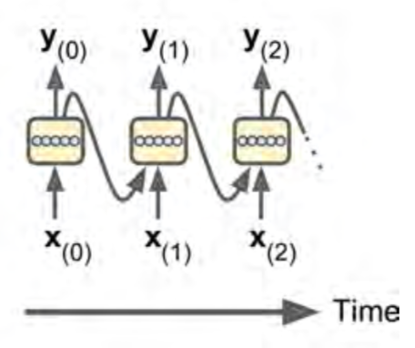
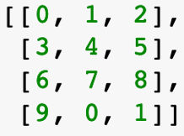
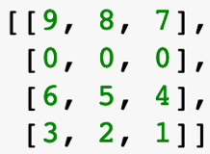
Chapter 14 (O'Reilly) of Hands-On ML

Slide 5
Graph

Slide 6
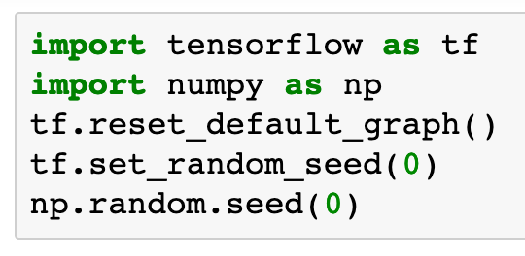

Slide 7

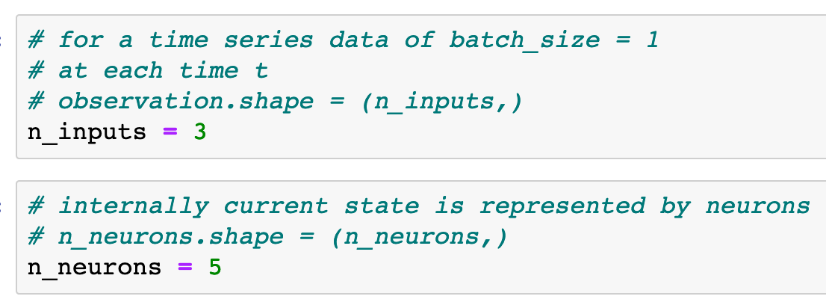
Chapter 14 (O'Reilly) of Hands-On ML

Slide 8
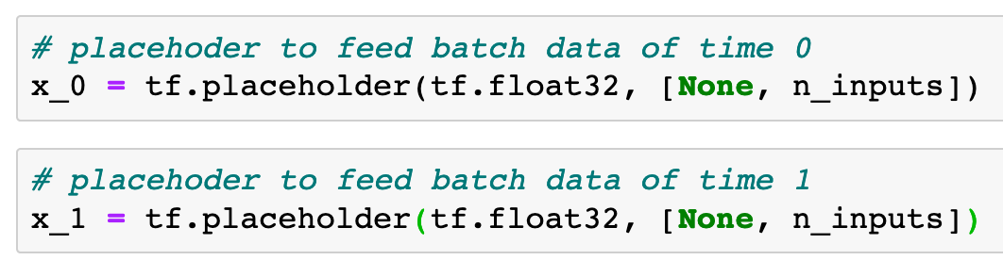
Chapter 14 (O'Reilly) of Hands-On ML

Slide 9
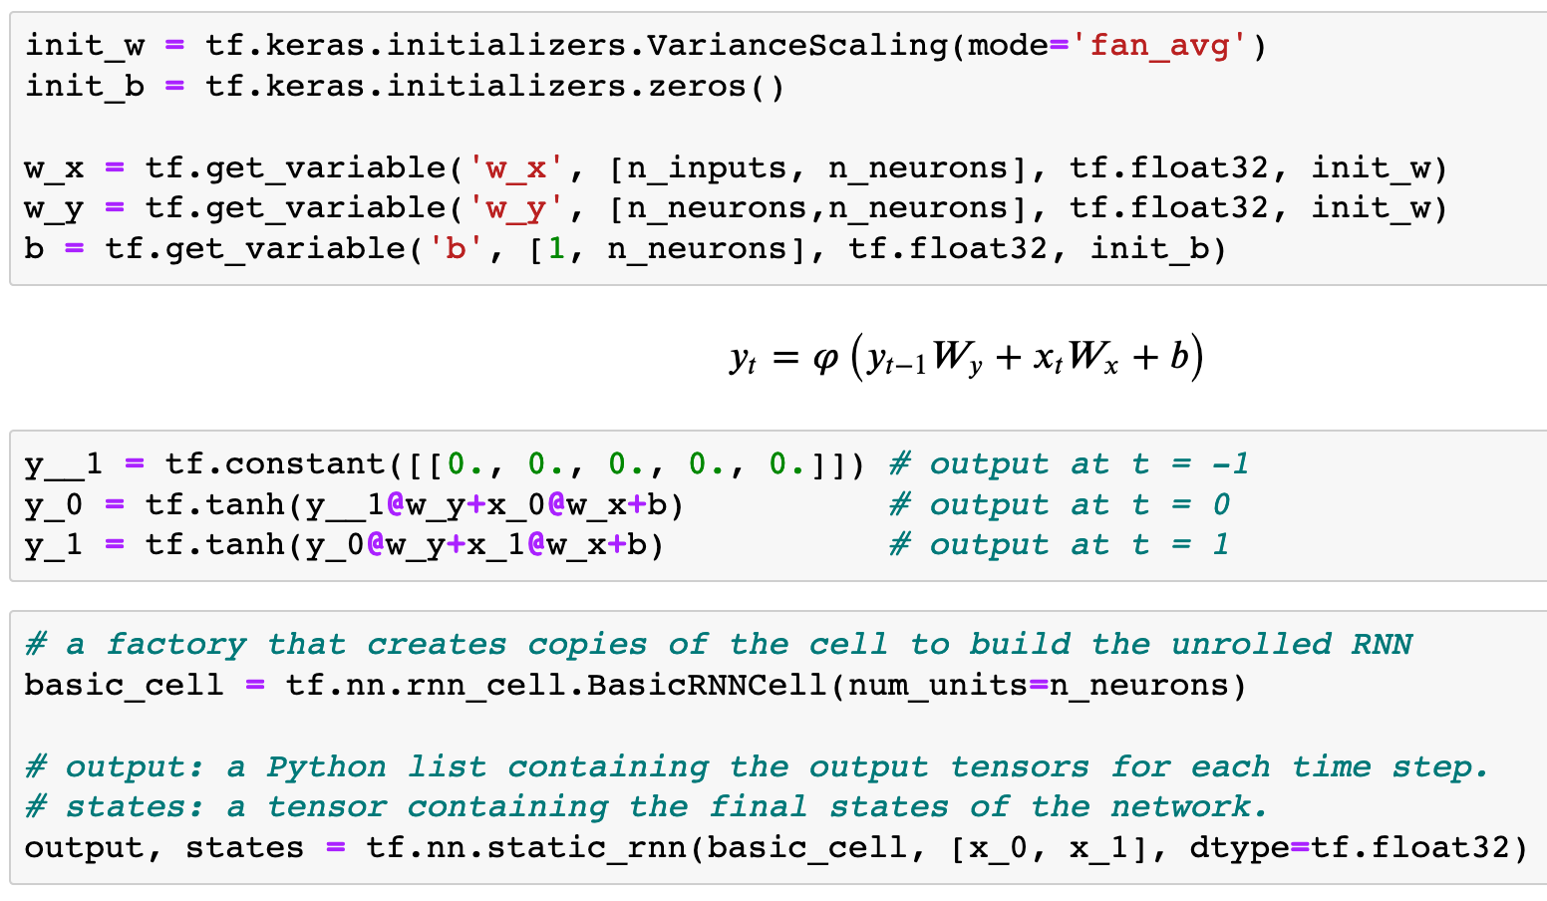

Previously
Now
Chapter 14 (O'Reilly) of Hands-On ML

Slide 10
Previously
Now
Chapter 14 (O'Reilly) of Hands-On ML

Slide 11
Previously
Now
Chapter 14 (O'Reilly) of Hands-On ML

Slide 12
Previously
Now
Chapter 14 (O'Reilly) of Hands-On ML

Slide 13
Previously
Now
Chapter 14 (O'Reilly) of Hands-On ML

Slide 14
Previously
Now
Chapter 14 (O'Reilly) of Hands-On ML

Slide 15
Previously
Now
Static RNN packs output.
Chapter 14 (O'Reilly) of Hands-On ML

Slide 16
Previously
Now
Static RNN packs output.
How to initialize variables different from default initialization?
Chapter 14 (O'Reilly) of Hands-On ML

Slide 17
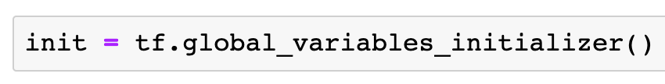

Slide 18
Session

Slide 19
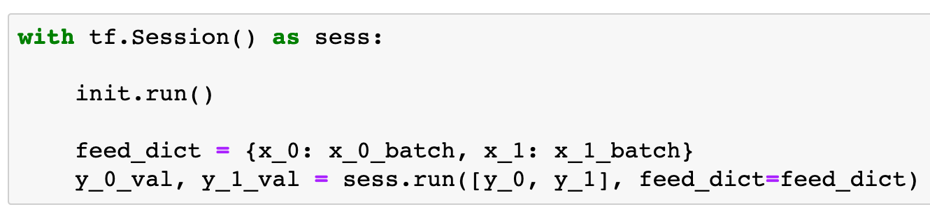

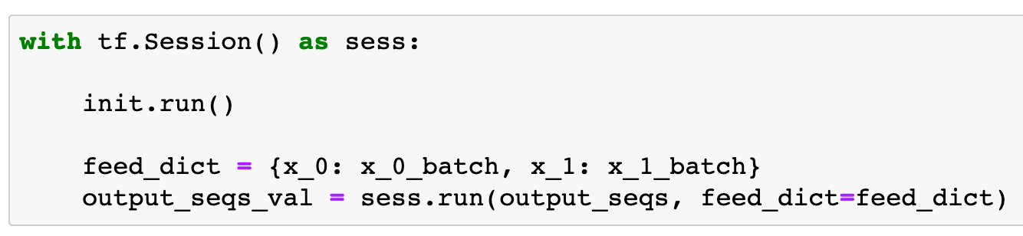
Previously
Now

Slide 20
Previously
Now

Slide 21
Previously
Now

Slide 22
Previously
Now

Slide 23
Previously
Now

Slide 24
Previously
Now

Slide 25
Report

Slide 26
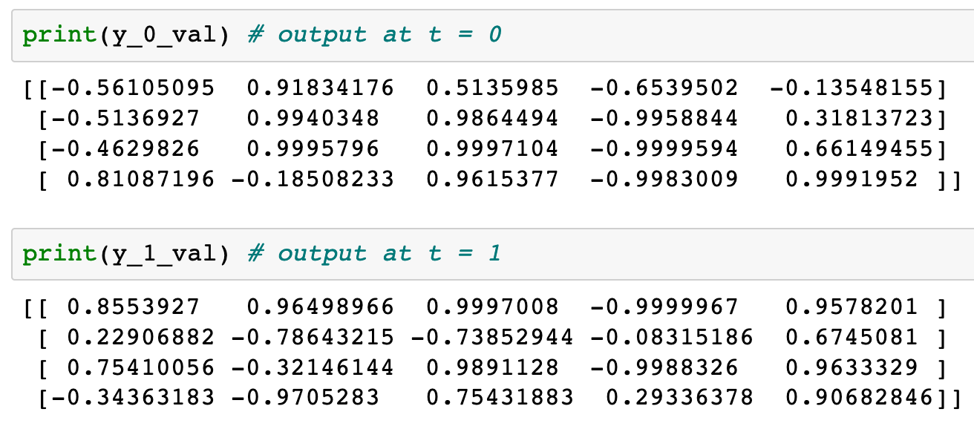
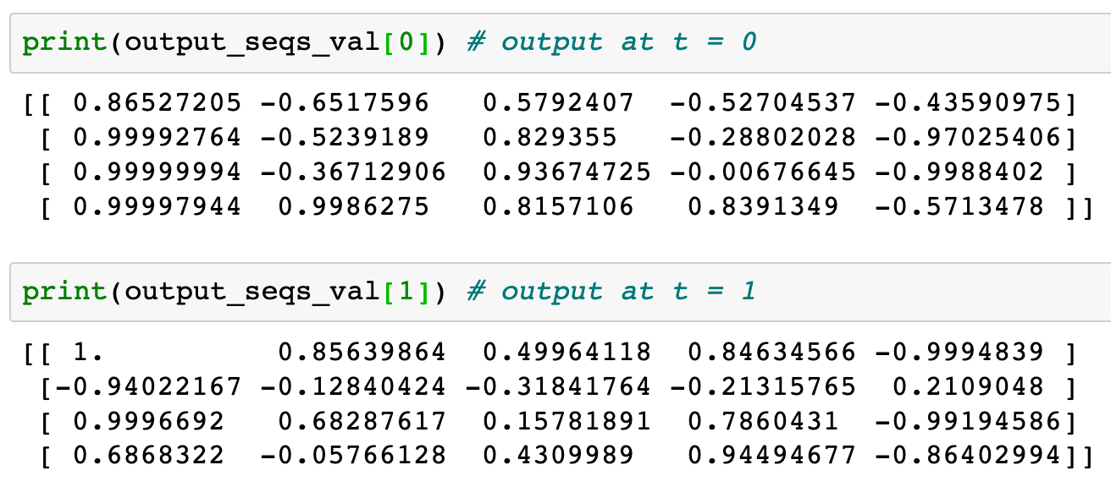
Previously
Now

Slide 27
Previously
Now

Slide 28
Previously
Now

Slide 29
Previously
Now

Slide 30
Previously
Now

Slide 31
Previously
Now

Slide 32
Now
Let’s Play with Code

